Slide 1
Read, Write, Inc.
Phonics and Reading Workshop

Slide 2
WELCOME
Phonics and Reading Workshop

Slide 3
Our aims for your child as a reader at Stretton Primary School
To develop a love of reading.
Develop fluency and independence.
Develop comprehension skills and understanding.
To be introduced to different authors and genres.
Have the opportunity to discuss and review books.

Slide 4
Why is reading important?
Reading is fundamental to education. Proficiency in reading, writing and spoken language is vital for pupils’ success. Through these, they develop communication skills for education and for working with others: in school, in training and at work.
Pupils who find it difficult to learn to read are likely to struggle across the curriculum, since English is both a subject in its own right and the medium for teaching (The reading framework: teaching the foundations of literacy July 2021)
Notes:
Reading underpins the whole curriculum, the importance of vocabulary, which will aid writing

Slide 5
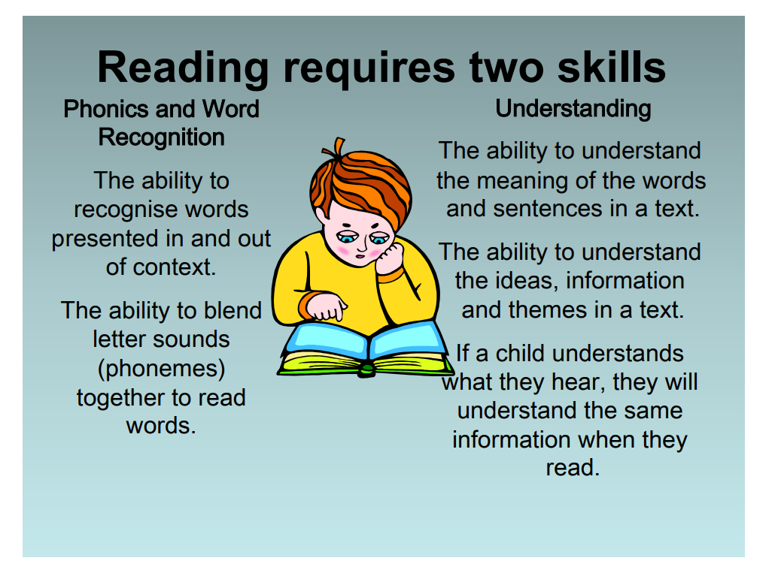

Slide 6
Reading
Reading involves understanding the meaning of print which is all around us – books, magazines, posters, advertisements, films, DVDs and computers
We read for many different reasons. It is good for the children to understand that we all read for pleasure, learning, to follow instructions and gain information
Reading at home does not always have to mean just our school reading books
Adults modelling reading to children is very important

Slide 7
Six early literacy skills
Vocabulary - wordless books and pictures. Do not underestimate the power of developing vocabulary through wordless books.
Print Motivation – to love books and the desire to look through different genres of books.
Print Awareness – difference between text and pictures. The different between a phoneme, word and sentence. To be aware of different fonts.
Narrative Skills – retelling stories even if it is through using the pictures.
Letter knowledge – linking sounds to letters.
Phonological awareness - ability to hear sounds in words. Can hear and create rhymes. Make up silly words by changing the first sound in a word: milk, nilk, pilk, rilk, filk.

Slide 8
New Reading Framework July 2021
The Reading Framework came out for all schools in July 2021 and made recommendations that school need to ensure they are teaching reading with an approved systematic synthetic phonics programme. Schools have until March 2022 to ensure this is in place.
RWI is an approved programme and research shows a positive impact on progress for all learners, when learning to read and write. The programme has been used in schools for many years with excellent progress rates. Our teachers have previous experience of this programme.

Slide 9
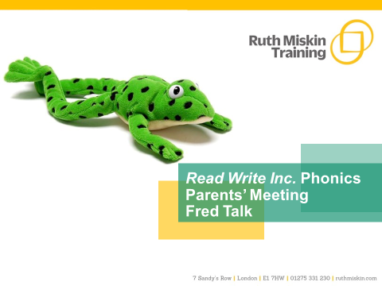

Slide 10
What is phonics?
Sounds also known as phonemes
Graphemes (letters we use to write the sound)
All words are made up of individual sounds. These sounds are merged together to form words.
e.g. in ‘mat’ we have the sounds ‘m’, ‘a’, ‘t’, ship – ‘sh’, ‘i’, ‘p’.
A grapheme is another name for the letters we use to write the sound. The spelling of that sound on the page.
Phonics is the method of teaching reading through the identification of sounds and graphemes.
The new National Curriculum ensures that all children are taught Phonics systematically.
This gives your children the tools to read any word.
Notes:
All words are made up of individual sounds. These sounds are merged together to form words.
e.g. in ‘mat’ we have the sounds ‘m’, ‘a’, ‘t’, ship – ‘sh’, ‘i’, ‘p’.
Click A grapheme is another name for the letters we use to write the sound. The spelling of that sound on the page.
Phonics is the method of teaching reading through the identification of sounds and graphemes.
The new National Curriculum ensures that all children are taught Phonics systematically.
This gives your children the tools to read any word.

Slide 11
Speed Sounds Set 1
Notes:
Remember that:
- Children need to know sounds – not letter names – to read words.
- We pronounce the sounds clearly, using pure sounds (‘m’ not’ muh’, ’s’ not ‘suh’, etc.) so that your child will be able to blend the sounds together to make words more easily.

Slide 12
Speed Sounds Set 2
Notes:
Set 2 sounds are shaded. They are long vowel sounds with 2 or more letters. We call these ‘Special Friends’ – two letters together that make one sound.
Let’s practise saying these sounds together.
Say each sound MTYT.
Once children know these Set 2 sounds, they know one way of reading and writing every sound.

Slide 13
Speed Sounds Set 3
Notes:
Once children know how to read Set 2 sounds, they start to learn Set 3 sounds.
These are shaded in the chart.
They are alternative graphemes (spelling of a sound) for the Set 1 and Set 2 sounds the children already know.
Point to the chart to show. For example, they know ‘ay’ and now learn a-e and ai as other spellings for the same sound.

Slide 14
Daily 30 minute discrete lesson each day
Assessment at the beginning of the term and after a block of teaching
Children are placed in the groups based on the assessments (sounds they need to learn)
They will revise the sounds previously learnt, learn a new sound, read green and red words, read the book x3 a week, write words/sentences

Slide 15
Read the book fluently, talk about new vocabulary, punctuation add expression
Comprehension (key questions).
This will feed into their writing.
Book sent home are to be read at home. At this stage they should be fluent and will concentrate on expression, punctuation and comprehension.

Slide 16

Name the pictures
Slither down the snake
Maisie mountain, mountain
Around the dinosaur’s bottom and up to his neck
Around the apple and down the leaf
Notes:
We give children a hook to learn the sounds by using pictures in the same shape as the letter.
‘s’ looks like a snake.
‘d’ looks like a dinosaur.
‘m’ looks like a mountain.
‘a’ looks like an apple.
We teach the children to name the mnemonic pictures before they learn the sound.
This means that children learn to read and write the sounds really easily.

Slide 17
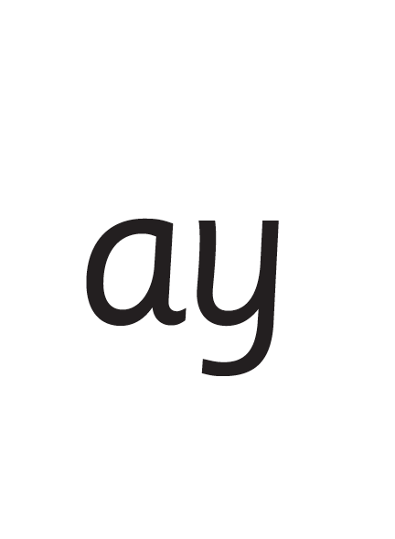
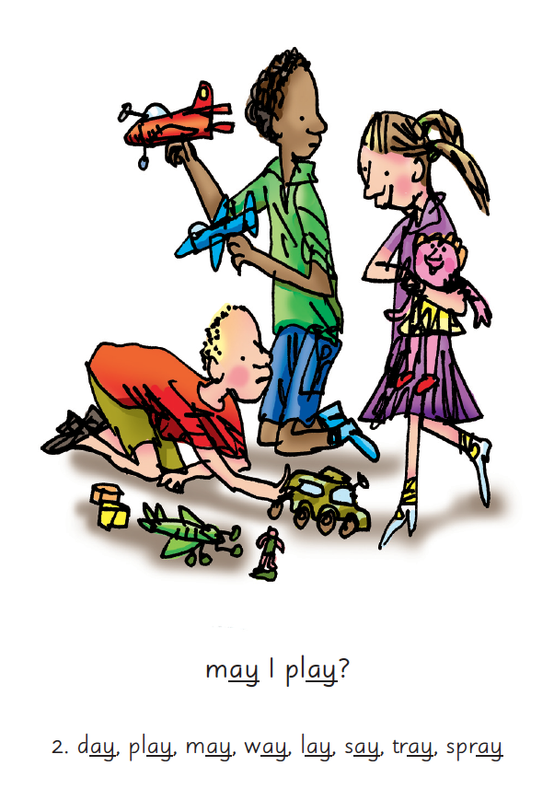

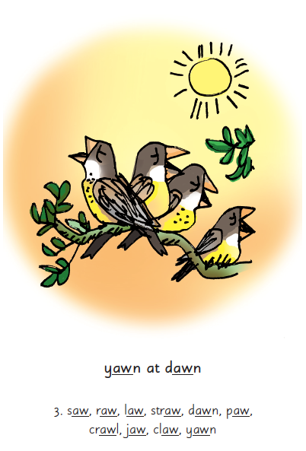
Picture Phrases
Notes:
We use picture phrases to help children remember the Set 2 and Set 3 sounds.
For example, ay, may I play? aw, yawn at dawn

Slide 18

Teaching letter formation
Notes:
Children use the picture mnemonic to learn to form letters correctly at the same time they learn to read each sound.
Each sound has a handwriting phrase e.g. down Maisie, and over the mountains.
Use these handwriting phrases when practising writing at home with your child.
Avoid using these to read the sound.
I will give you a handout of these handwriting phrases when you leave today.

Slide 19
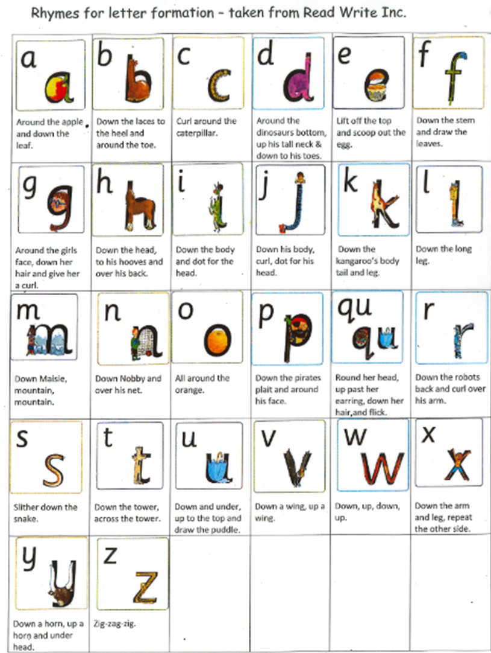
What can I do?
1. Use pure sounds, not letter names
2. Teach the picture names
3. Practise reading sounds speedily -
‘review, review, review’
4. Use the handwriting phrases for writing only
Notes:
Show how to use ‘My Set 1 Speed Sounds Book 1’ or cards if you send these home.
You can purchase Set 1 flashcards or My Reading and Writing Kit ages 3-5 early sounds and blending to support your child with Set 1 sounds at home.

Slide 20


Sounds + blending = reading
+
Notes:
Today I want to help you understand how your child is learning to read words in Read Write Inc. Phonics by blending sounds together:
Alongside teaching children sounds, we teach them to blend sounds to read words e.g. s-a-t, sat.
We use Fred Talk to help children read.

Slide 21




Reading with Fred Talk
Notes:
We teach children to read words using Fred Talk to blend together the sounds they know e.g. m-a-t, mat.
We say ‘Fred Talk, read the word’.

Slide 22


‘Special Friends’, ‘Fred Talk’, read the word
Notes:
Then children practise reading these sounds in words using the routine ‘Special Friends’, ‘Fred Talk’, read the word’.
They spot the ‘Special Friends’ first, then Fred Talk to read the word.
For example, ‘ay’, s-p-r-ay, spray.

Slide 23

Fred Talk routine
Say the word in sounds as Fred e.g. c-a-t.
Ask your child to repeat. Can they ‘jump-in’ with the whole word?
Say the word in sounds followed by the whole word e.g. c-a-t, cat
Ask your child to repeat
Notes:
Fred Talk follows a consistent routine:
Say the word in sounds as Fred e.g. c-a-t. Ask children to repeat. Pause to allow children to ‘jump-in’ with the whole word.
Say the word in sounds followed by the whole word e.g. c-a-t, cat. Ask children to repeat.

Slide 24
Fred games and Fred talk throughout the day
l
-u
?
Shall we have some
What would you like to
Let’s put on your
-ch
-n
-ay
-l
p
?
-oa
-t
c
.
Notes:
Try to use Fred Talk throughout the day at home to help your child practise blending sounds together.
Fred Talk words at the end of the sentence and keep the words short and simple.
With the person next to you, have a practise of the three sentences on the screen.
Remember to Fred Talk the last word of the sentence.
You can also play Fred Games with your child at home. I will show you one of these in action in a moment,

Slide 25
The more that you read, the more things you will know. The more that you learn, the more places you’ll go!
Dr. Seuss
Notes:
In the words of Dr Seuss…read quote.
Good readers do well in school – and in life.
By listening to your child read, you are making sure they have the opportunity to practise and become a good reader quickly.
Remember that all parents have the power to change outcomes for their children.

Slide 27
Read Write Inc. Phonics
Parents’ Meeting
Listening to your child read
Notes:
Approximately 20 minutes is needed for this session.
Notes are provided to help you lead the presentation.
Notes in italics are for your attention only.
Provide copies of ‘Reading at Home Booklet 1 or 2’ from Oxford Owl.
Booklet 1 is sound groups and Ditty/ Red Groups and Booklet 2 for Green – Grey Storybooks.
Children will make the best possible progress if they read as often as possible.
Today we are going to discuss how to listen to your child read their Read Write Inc. Phonics decodable storybook when they bring it home.

Slide 28
‘Three with me, four at home’
Accuracy
Fluency
Comprehension
Read and enjoy at home
Notes:
In our school, children read each Read Write Inc. Storybook three times in class with their partner.
Re-reading the same book helps children to become confident readers. Each time they re-read, they build their fluency/speed and comprehension.
They love reading and want to read because they can read all of the words in the Storybook.
We set a focus for each re-read in school.
(Click) The first read focuses on reading every word accurately.
(Click) The second on reading the story more quickly.
(Click) The third read on comprehension - understanding what they read.
Then your child brings the same book home to read and enjoy with you again and again at home.
It’s ‘three with me, four at home.’
We do not send stories home the children cannot read because we always want them to be set up to succeed in their reading.
We want to make sure they enjoy reading so that they want to read.
The more they read, the faster progress they will make.

Slide 29


‘Special Friends’, ‘Fred Talk’, read the word
Notes:
E Children will be able to read all of the words in the Storybook.
If they hesitate, remind them to read the word using ‘Special Friends, Fred Talk, read the word’.
For example, this means they spot the ‘sh’, then Fred Talk and blend to read the word e.g. sh, sh-i-p, ship.

Slide 30


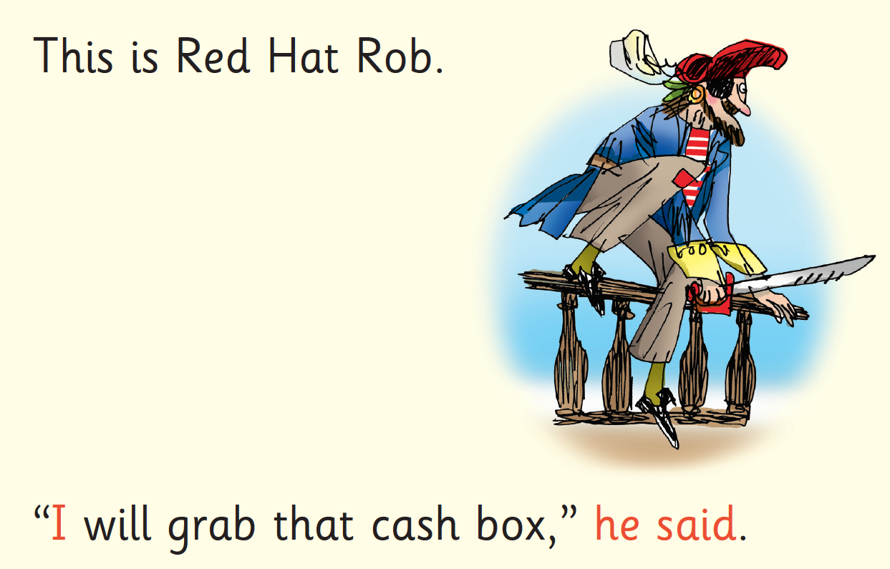
Red Words (tricky words)
Notes:
Some words are ‘tricky’ because they contain letters that don’t match the sounds the child has been taught.
For example, ‘said’ has ‘ai’ making an ‘e’ sound.
We teach these common exception words as Red words.
In the early Storybooks, these words are printed in red text.
Remind your child not to use Fred Talk to read Red words but instead to stop and think. Tell them the word if needed.

Slide 31


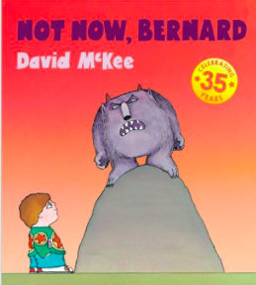

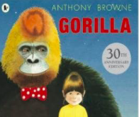
Repeated readings
Again! Again!
Children are wired to thrive on repetition
Notes:
Stories provide a wealth of language we don’t use in everyday talk.
The more stories, poems and nursery rhymes children know well, the more easily they will be able to understand what they read, when they can read.
Children thrive on repetition.
Take Sophie who is 2 ½ years old.
She begs for her favourite stories to be read over and over again.
The more her mum repeats the story, the more the story ‘belongs’ to Sophie.
Sophie ‘reads’ it, copying the special emphasis and actions that her mum used every time she read the story to her.

Slide 32
10 things your child learns when you read aloud stories and poems every day
Sustain attention
Appreciate rhythm and rhyme
Build pictures in their minds from the words on the page
Understand humour and irony
Use new words and phrases in different contexts - and later in writing
Learn new vocabulary and knowledge of the world
Think about characters’ feelings and use appropriate voices
Follow a plot with all its twists and turns
Understand suspense and predict what’s about to happen next
Link sentences and ideas from one passage to the next
Notes:
Look at all these things you child will learn when you read aloud stories and poems, - without any teaching!
Click each point and read.

Slide 33


Slide 34
Top Tips - Storytime
Make it a treat
Make it a special quiet time
Show curiosity
Read story once without stopping
Chat about the story
Avoid testing with questions until after the read
Link to other stories and experiences
Read favourites over and over again
Use different voices
Love the book
Notes:
Here are our ten top tips for Storytime at home.
Make it a treat – introduce each new book with excitement.
Make it a special quiet time – cuddle up!
Show curiosity in what you’re going to read.
Read story once without stopping so they can enjoy the whole story. . If you think your child might not understand something say something like ‘Oh I think what’s happening here is that…”
Chat about the story e.g. I wonder why he did that? Oh no, I hope she’s not going to…
Avoid asking questions to test what they remember.
Link to other stories and experiences you have shared e.g. this reminds me of…
Read favourites over and over again – encourage your child to join with the bits they know. Avoid saying ‘not that story again!’
Use different voices – be enthusiastic!
Love the book – read with enjoyment.
I will give you a handout with these tips when you leave today.

Slide 35
Have fun!
Useful websites
https://www.oxfordowl.co.uk/for-home/
https://www.booktrust.org.uk/books-and-reading/
https://www.phonicsplay.co.uk/ comics and interactive games
www.ictgames.com
https://www.roythezebra.com/
https://www.youtube.com/watch?v=BqhXUW_v-1s&safe=true (articulation of phonemes)
https://www.wegettoteach.com/resources
https://www.youtube.com/watch?v=UCI2mu7URBc&safe=true Clip to show how to pronounce pure sounds
Follow fiveminutemum on Instagram or purchase her book for making phonics, reading and writing learning at home quick and fun.

Slide 36
Developing A Growth Mindset
Tips- for reluctant readers
Encourage children using specific praise e.g. good effort, you sounded out/blended, remembered the special friends well
Encourage a growth mindset ‘have a go’
Pick the most productive time of the day-children seem to read best in the morning, could you read in the car before you come into school
Encourage children to use what they know e.g. phonics, picture clues etc.
Comments in reading record book-I would love to hear your reading, your teachers have said how well you are doing!
I read, then you read-take it in turns because sometimes reading a whole page can be overwhelming
Online resources and phonic games
Now and next - Lets do reading and then you can play with your Lego or ……
Set expectations- we are going to read and then you can…..
Refer to the suggested strategies to support reading

Slide 37
Read Write Inc. Phonics
Parents’ Meeting –
Phonics Screening Check
Notes:
Approximately 10 minutes is needed for this session.
Notes are provided to help you lead the presentation.
Notes in italics are for your attention only.

Slide 38


Slide 39
What is the Phonics Screening Check?
A word-reading test at the end of Year 1
Year 2 will be taking it in Autumn 2 this year
Children read 40 words
Notes:
Children complete a word-reading check at the end of Year 1 so that parents can be confident their children are being taught to read successfully.
Children read 40 words. It takes between two and five minutes.
If they do not manage to read 32 of the words, they are given extra support, and repeat the check at the end of Year 2.
It means that all children will be able to read accurately before they begin Year 3.
In our school, we aim to make sure that every child learns to read accurately by the end of Year 1 so they are set up for success in school and in life.
As soon as we spot a child who needs extra practice learning to read sounds and words, we teach them one-to-one for a few minutes every day.

Slide 40
‘Special Friends’, ‘Fred Talk’, read the word
Notes:
We teach children to read both real and nonsense words using the routine ‘Special Friends’, ‘Fred Talk’, read the word’.
Children spot the ‘Special Friends’ (two letters that make one sound), Fred talk the word, and then read the word as a whole.
For example, ‘sh’, sh-i-p, ship.

Slide 41




Nonsense words
Notes:
Half of the words in the check are real words.
Half are nonsense words. For example, ‘sheb’, ‘glight’, ‘ched’, ‘teb’.
There is a picture of an alien next to each word to remind the children that it isn’t a real word.
Nonsense words check that children will be able to read sounds they know in unfamiliar words.
Children who can read nonsense words will, very soon, be able to read any new word – for example – gargantuan, flailing, raucous, anticipation;
Reading new words increases children’s vocabulary rapidly.

Slide 42
Online resources available
Ruth Miskin Parents’ Page:
http://www.ruthmiskin.com/en/parents/
Ruth Miskin Facebook:
https://www.facebook.com/miskin.education
Free e-books for home reading:
http://www.oxfordowl.co.uk/Reading/

Slide 43


